Slide 1
Control Development
Part B: Control Design and Implementation
A control is any process, policy, device, practice, or other actions that modify risk.” In reviewing many risk registers, “controls” are identified as many things, including: Policies e.g. HR Policy.
Controls can be technical solutions, such as firewalls or intrusion detection systems, but they can also be processes, procedures, policies, or physical controls.
Types of controls (administrative/managerial, technical/logical, and physical/operational),
Controls also can be grouped in different families: access control, auditing, configuration management, contingency planning, personnel security, and so on.

Slide 2
  Mitigation is by far the most common response to risk.
  Controls are implemented to reduce or maintain risk at acceptable levels; however, controls may be poorly maintained, unsuitable for the risk that they are meant to control or incorrectly configured.
  Controls should be regularly reviewed to determine and ensure their effectiveness.
  In addition to evaluating the effectiveness of each control for its intended purpose, the risk practitioner should verify the correct balance between technical, administrative (managerial) and physical controls.
  For example Implementation of a technical control, such as a firewall, requires training for the staff member who manages or operates it, correct procedures for its configuration, assignment of responsibilities for its monitoring and schedules for regular testing.

Slide 3
Control Types
PREVENTIVE
  Preventive controls prevent actions from occurring. It applies restrictions to what a potential user, either authorized or unauthorized, can do.
  The assigning of privileges on a system is a good example of a preventive control because having limited privileges prevents the user from accessing and performing unauthorized actions on the system.
  An example of an administrative preventive control is a pre-employment drug screening. It is designed to prevent an organization from hiring an employee who is using illegal drugs.
DETECTIVE
  Detective controls are controls that alert during or after a successful attack.
  Intrusion detection systems alerting after a successful attack, closed-circuit television cameras (CCTV) that alert guards to an intruder, and a building alarm system that is triggered by an intruder are all examples of detective controls.

Slide 4
CORRECTIVE
  Corrective controls work by “correcting” a damaged system or process.
  The corrective access control typically works hand in hand with detective access controls.
  Antivirus software has both components. First, the antivirus software runs a scan and uses its definition file to detect whether there is any software that matches its virus list. If it detects a virus, the corrective controls take over, places the suspicious software in quarantine, or deletes it from the system.
RECOVERY
  After a security incident has occurred, recovery controls may need to be taken in order to restore functionality of the system and organization.
  Recovery means that the system must be recovered: reinstalled from OS media or image, data restored from backups, etc.
  The connection between corrective and recovery controls is important to understand. For example, let us say a user downloads a Trojan horse. A corrective control may be the antivirus software “quarantine.” If the quarantine does not correct the problem, then a recovery control may be implemented to reload software and rebuild the compromised system.

Slide 5
DETERRENT
  Deterrent controls deter users from performing actions on a system.
  Examples include a “beware of dog” sign: a thief facing two buildings, one with guard dogs and one without, is more likely to attack the building without guard dogs.
  A large fine for speeding is a deterrent for drivers to not speed. A sanction policy that makes users understand that they will be fired if they are caught surfing illicit or illegal Web sites is a deterrent.
COMPENSATING
  A compensating control is an additional security control put in place to compensate for weaknesses in other controls.
  For example, surfing explicit Web sites would be a cause for an employee to lose his/her job. This would be an administrative deterrent control. However, by also adding a review of each employee’s Web logs each day, we are adding a detective compensating control to augment the administrative control of firing an employee who surfs inappropriate Web sites.

Slide 6
more clear-cut examples:
Preventive
    • Physical: Lock, mantrap
    • Technical: Firewall
    • Administrative: Pre-employment drug screening
  Detective
    • Physical: CCTV, light (used to see an intruder)
    • Technical: IDS
    • Administrative: Post-employment random drug tests
  Deterrent
    • Physical: “Beware of dog” sign, light (deterring a physical attack)
    • Technical: Warning Banner presented before a login prompt
    • Administrative: Sanction policy

Slide 7
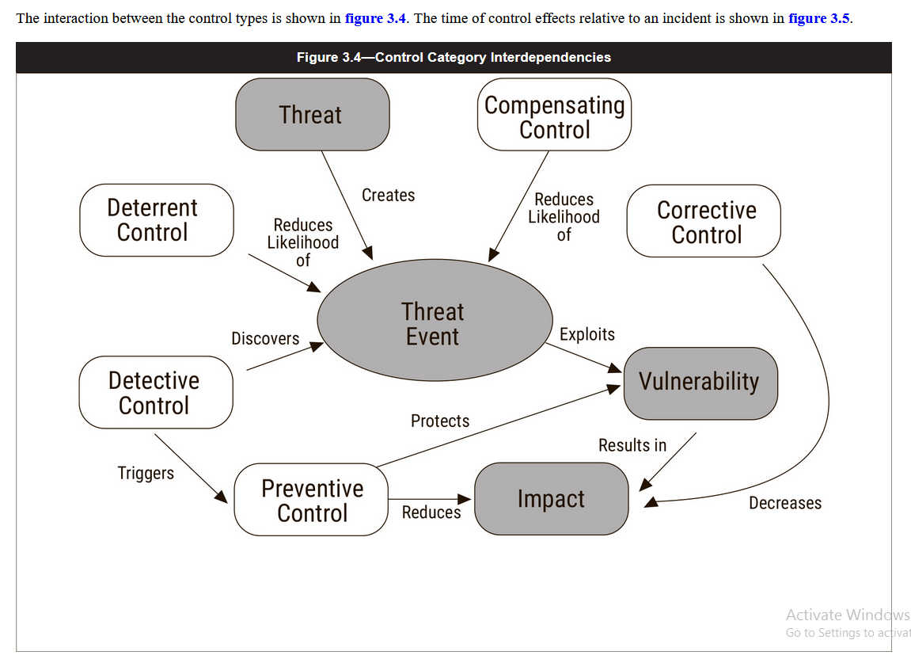

Slide 8
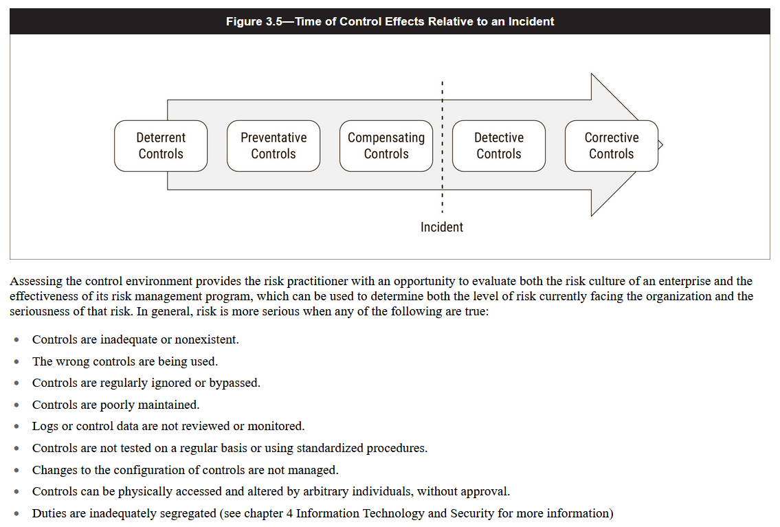

Slide 9
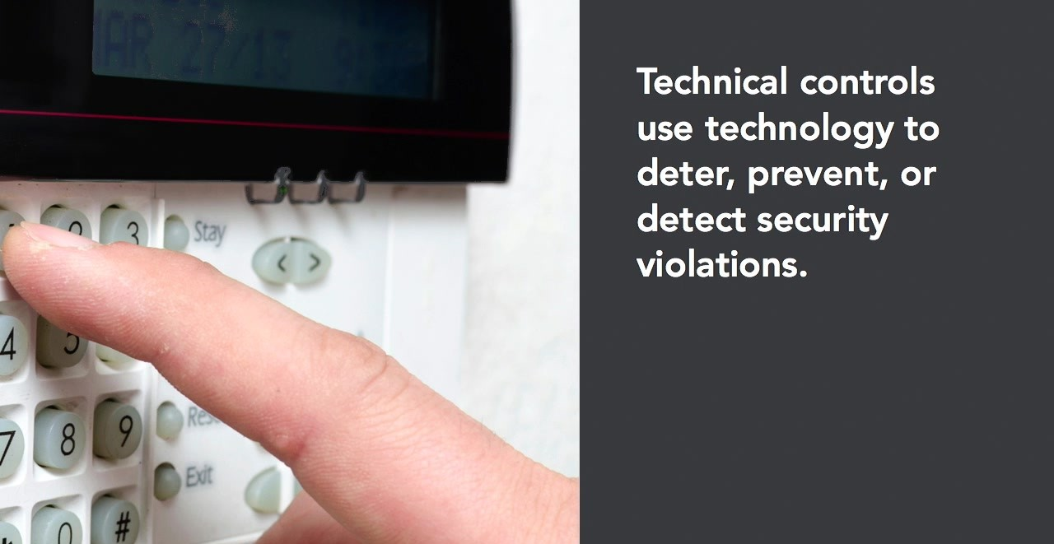

Slide 10
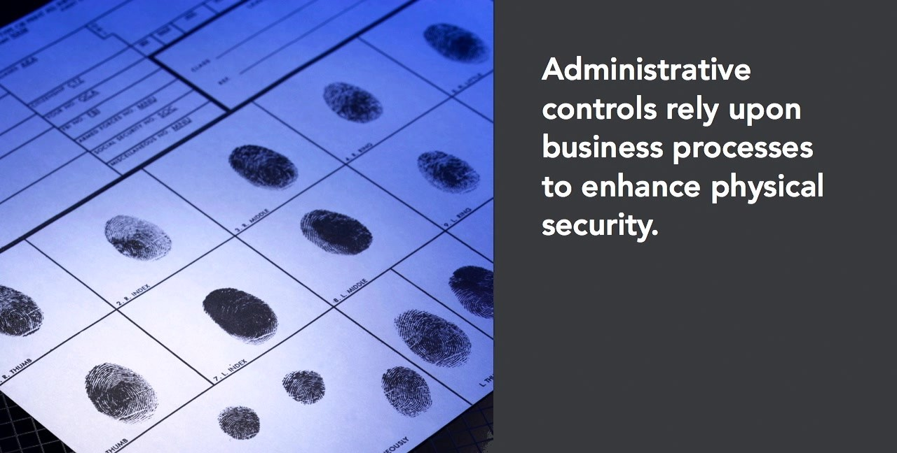

Slide 11



Slide 12
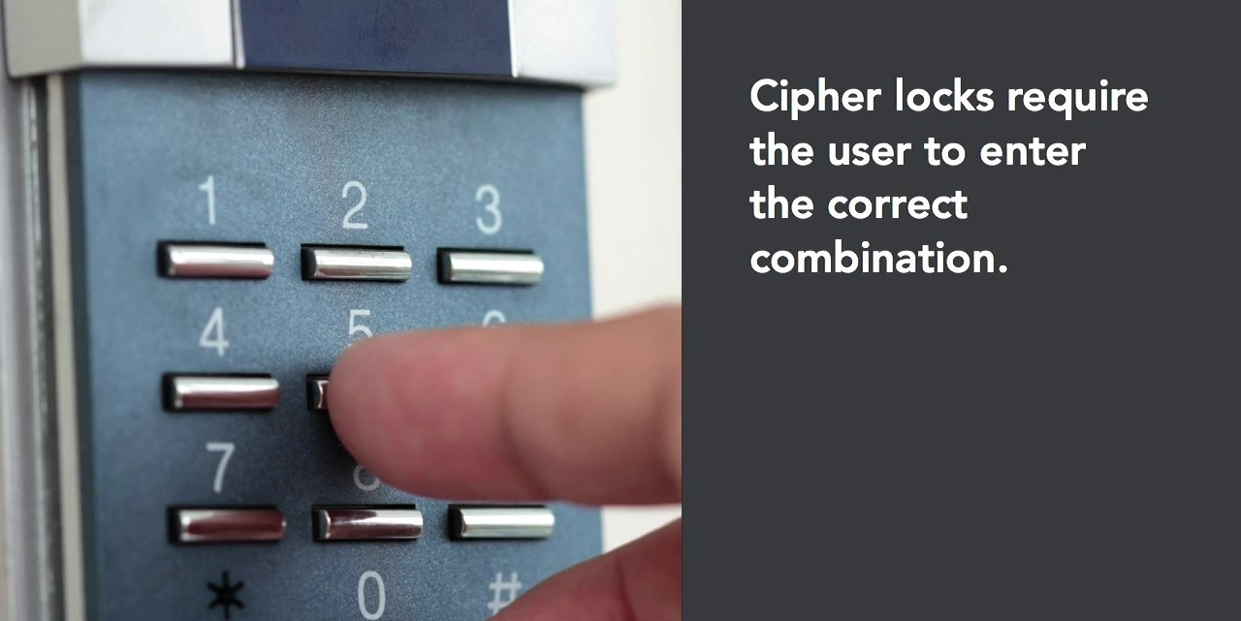

Slide 13
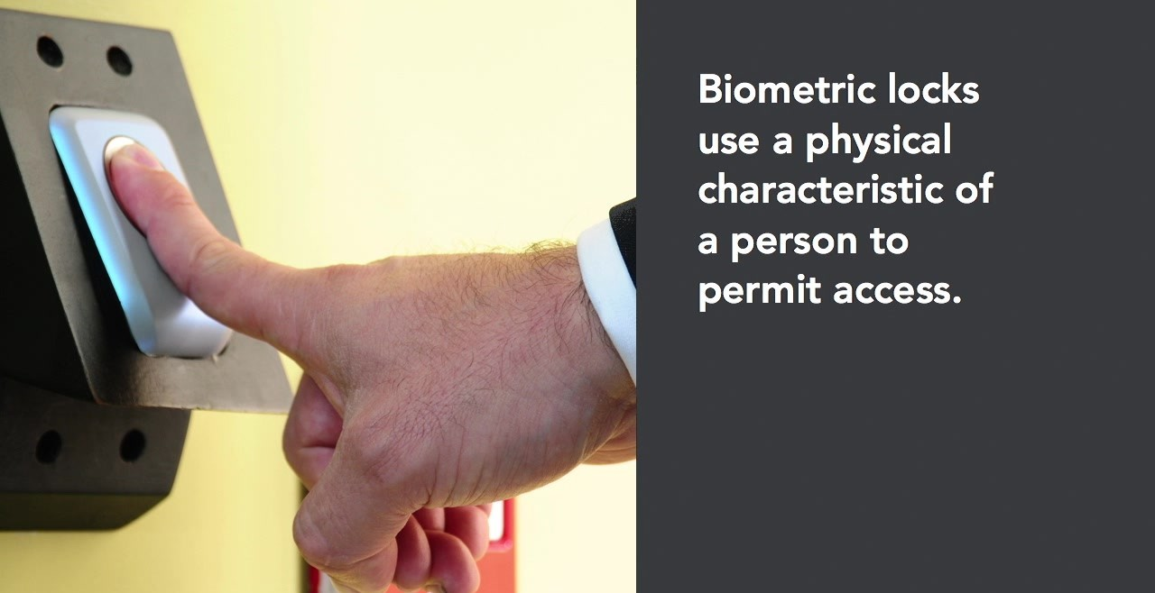

Slide 14
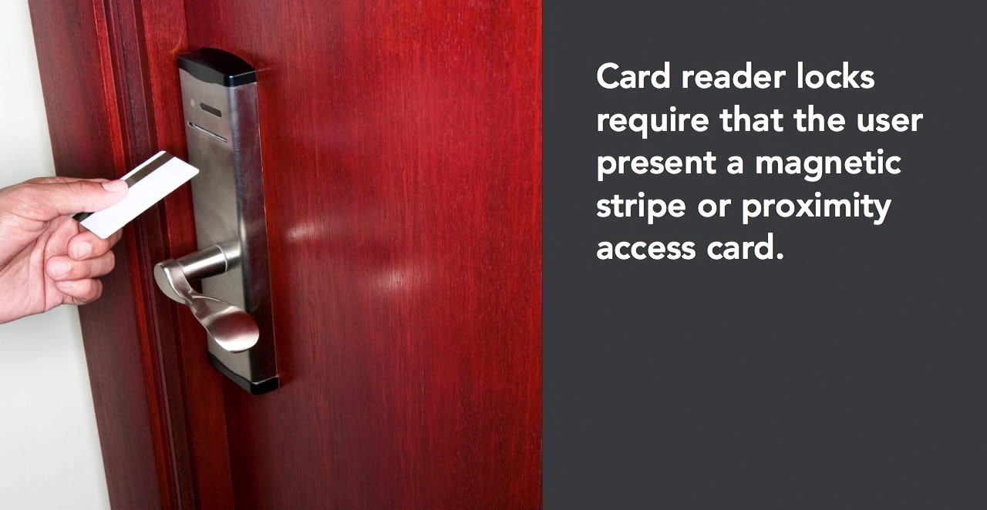

Slide 15
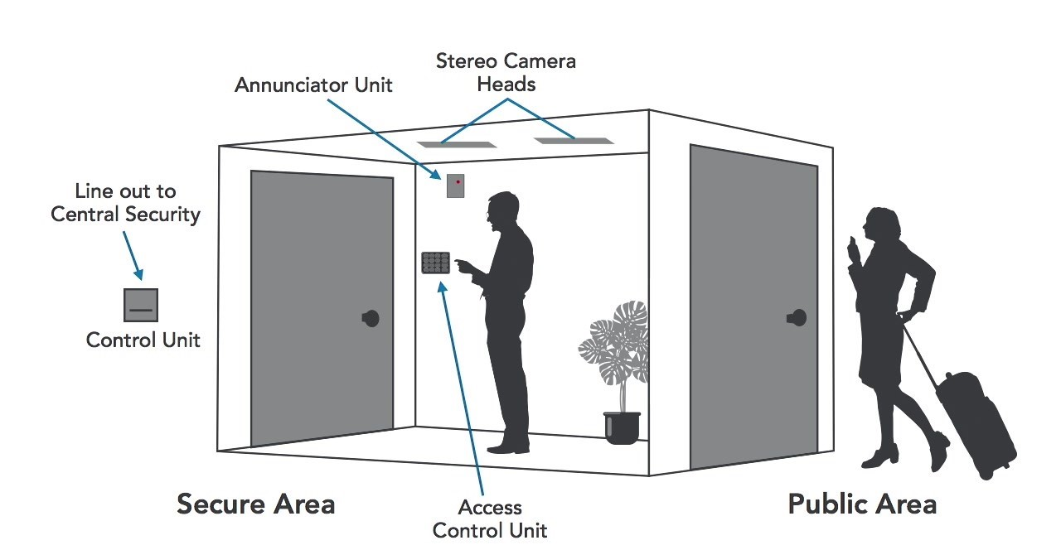

Slide 16
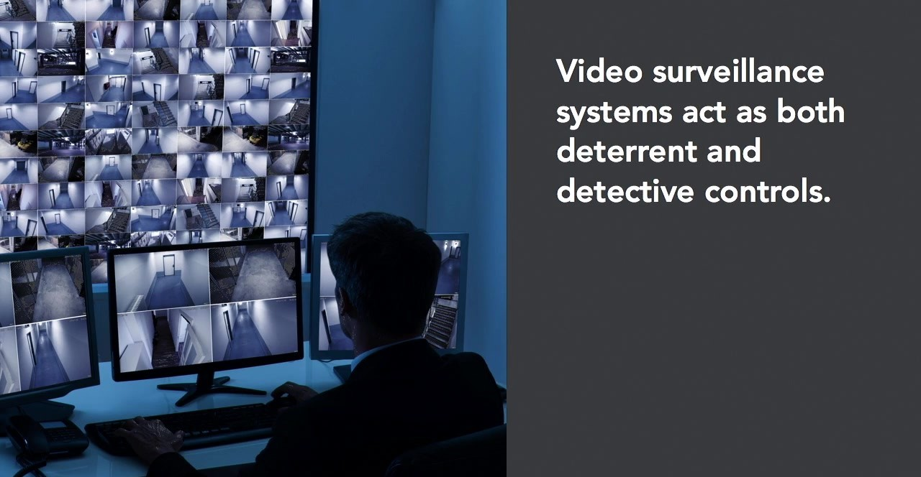

Slide 17


Slide 18
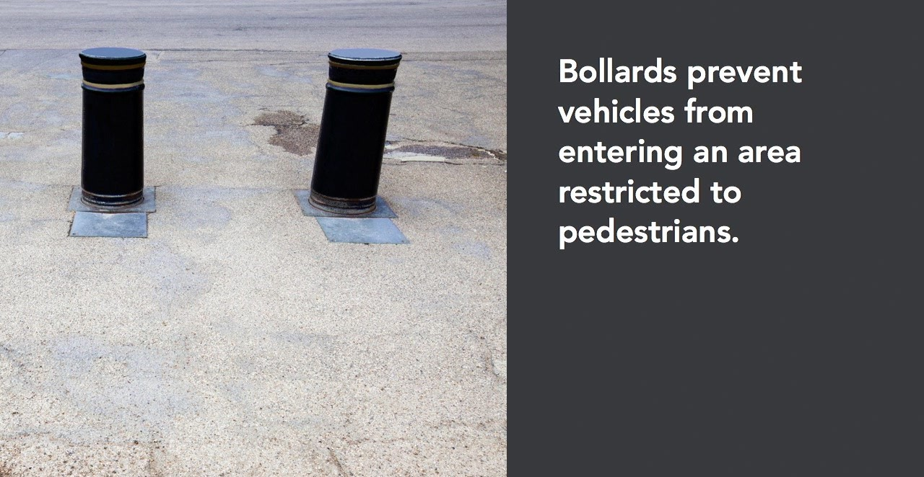

Slide 19
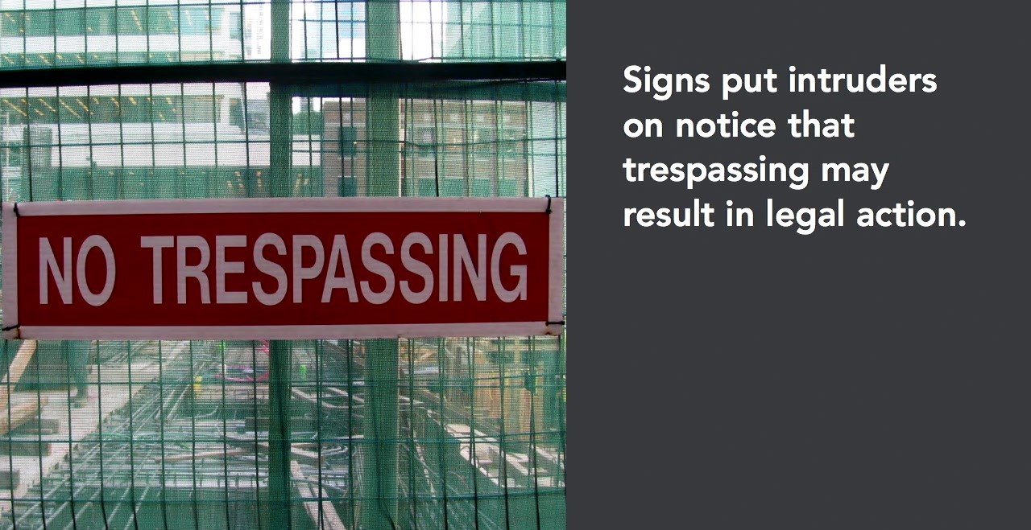

Slide 20
Control Standards and Frameworks
  Selection of controls requires evaluation and implementation.
  Adoption of standards and frameworks facilitates the process of selecting controls by specifying what should be done .
  The 27000-series of standards from the International Standards Organization (ISO) focuses on information security, with ISO/IEC 27002:18 dealing specifically with security controls.
  Many industries also have standards for security within their respective sectors. For instance, the Payment Card Industry Data Security Standard (PCI DSS) is used by all organizations that process debit or credit cards.
  Similar standards are found in the healthcare, accounting, audit and telecommunications industries.
  The U.S. National Institute of Standards and Technology (NIST) maintains a published Cybersecurity Framework (CSF) .
  Similarly, the Cloud Security Alliance (CSA) has built a control framework tailored to the operational and security requirements of cloud computing.

Slide 21
Selecting control
Framework
Several high quality control
Framework are available for
Organization to start with as
Opposed to start from scratch

Slide 22
NIST SP 800-53
Developed by the U.S. National Institute for Standards and Technology, NIST Special Publication (SP) 800-53, “Security and Privacy Controls for Federal Information Systems and Organizations,” is one of the most well-known and adopted security control frameworks.
NIST SP 800-53 is required for all U.S. government information systems, as well as all information systems in private industry that store or process information on behalf of the U.S. federal government.
NIST controls are organized into 18 categories:
  • Access control
  • Awareness and training
  • Audit and accountability
  • Security assessment and authorization
  • Configuration management
  • Contingency planning
  • Identification and authentication
  • Incident response
  • Maintenance
  • Media protection
  • Physical and environmental protection
  • Planning
  • Personnel security
  • Risk assessment
  • System and services acquisition
  • System and communications protection
  • System and information integrity
  • Program management

Slide 23
HIPAA
The U.S. Health Insurance Portability and Accountability Act established requirements for the protection of electronic protected health information (EPHI).
These requirements apply to virtually every corporate or government entity (known as a covered entity) that stores or processes EPHI.
HIPAA requirements fall into three main categories.
  • Administrative safeguards
  • Physical safeguards
  • Technical safeguards
Several controls reside within each of these three categories. Each control is labeled as Required or Addressable. Controls that are labeled as Required must be implemented by every covered entity. Controls that are labeled as Addressable are considered optional in each covered entity, meaning the organization does not have to implement an Addressable control if it does not

Slide 24
Center for Internet Security Critical Security Controls
The Critical Security Controls (CSC) framework from the Center for Internet Security (CIS), known as CIS CSC 20, is a well-known control framework that traces back to the SANS organization.
The framework is still commonly referred to as the “SANS 20” or “SANS 20 Critical Security Controls.”
The CIS CSC control categories are as follows:
  • Inventory of Authorized and Unauthorized Devices
  • Inventory of Authorized and Unauthorized Software
  • Secure Configurations for Hardware and Software on Mobile Devices, Laptops, Workstations, and Servers
  • Continuous Vulnerability Assessment and Remediation
  • Controlled Use of Administrative Privileges
  • Maintenance, Monitoring, and Analysis of Audit Logs
  • E-mail and Web Browser Protections
  • Malware Defenses
  • Limitation and Control of Network Ports, Protocols, and Services
  • Data Recovery Capability
  • Secure Configurations for Network Devices such as Firewalls, Routers, and Switches
  • Boundary Defense
  • Data Protection
  • Controlled Access Based on the Need to Know
  • Wireless Access Control

Slide 25
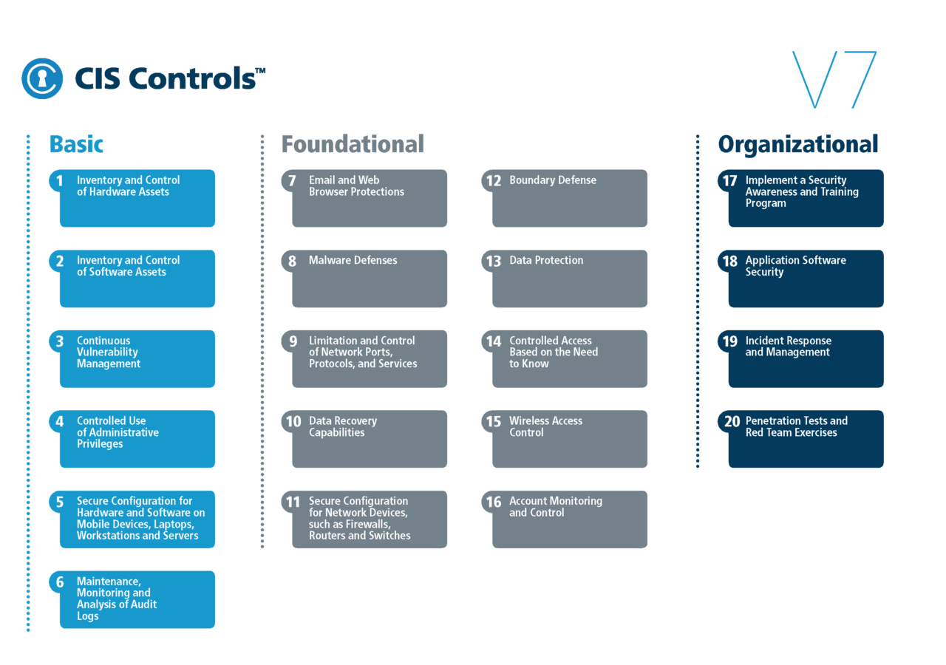

Slide 26
PCI-DSS
The Payment Card Industry Data Security Standard is a control framework specifically for the protection of credit card numbers and related information when stored, processed, and transmitted on an organization’s networks.
The PCI-DSS was developed by the PCI Standards Council, a consortium of the world’s dominant credit card brands, namely, Visa, MasterCard, American Express, Discover, and JCB.
The PCI-DSS has 12 control objectives:
  • Install and maintain a firewall configuration to protect cardholder data.
  • Do not use vendor-supplied defaults for system passwords and other security parameters.
  • Protect stored cardholder data.
  • Encrypt transmission of cardholder data across open, public networks.
  • Protect all systems against malware and regularly update antivirus software or programs.
  • Develop and maintain secure systems and applications.
  • Restrict access to cardholder data by business need to know.
  • Identify and authenticate access to system components.
  • Restrict physical access to cardholder data.
  • Track and monitor all access to network resources and cardholder data.
  • Regularly test security systems and processes.
  • Maintain a policy that addresses information security for all personnel.
PCI-DSS is mandatory for all organizations that store, process, or transmit credit card data. Organizations with larger volumes of card data are required to undergo annual on-site audits.

Slide 27
Capability Maturity Models
The risk practitioner may find it useful to compare the state of the enterprise risk management program to an established model of capability maturity that contains the essential elements of effective processes for one or more disciplines.
A capability maturity model (CMM) describes The improvement path from ad hoc, immature processes to disciplined, mature processes with improved quality and effectiveness.
With the aid of a maturity model, enterprises can set realistic long-term goals for risk management by having a clear understanding of their current maturity (in terms of current working practices) and the areas that require improvement.
A mature enterprise is more likely to prevent incidents, detect incidents sooner and recover rapidly from incidents.
As a general rule, enterprises should seek to implement well- structured risk management procedures across all departments and regions and ensure that every business process, system and software development project follows core risk management principles, policies, procedures and standards.
Improvements in both the efficiencies and effectiveness of the risk management capability are based on the consistent application of policies and procedures. If these procedures are followed on a consistent basis, then the efficiency and effectiveness of the risk management practices will improve.

Slide 28
Key elements that may be used to measure the maturity of IT risk management capability include:
  Support of senior management
  Regular communication between stakeholders
  Existence of policies, procedures and standards
  Availability of a current business impact analysis
  Logging and monitoring of system activity
  Regular review of logs
  Scheduled risk assessments and review
  Testing of business continuity and disaster recovery plans
  Training of staff
  Involvement of risk principles and personnel in IT projects
  Gathering feedback from users and stakeholders
  Validating the risk appetite and risk acceptance levels
  Time to detect/resolve a security incident
  Risk mitigation strategies
  Standardized measures for assessing risk and defining risk ratios
  Exception management
  Risk and control ownership
  Risk mitigation strategies
  Standardized measures for assessing risk and defining risk ratios
  Exception management
  Risk and control ownership

Slide 29
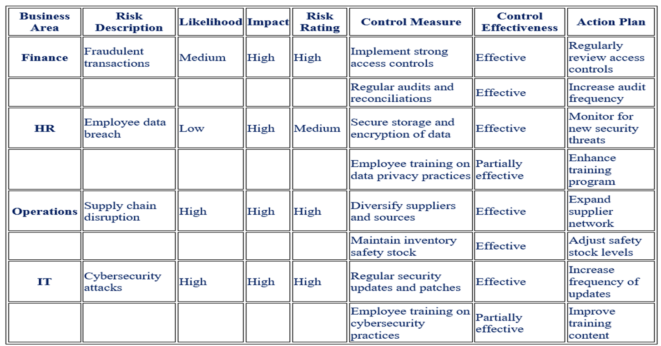
Utilizing a Risk and Control Matrix (RACM) for Effective Risk Management
A Risk and Control Matrix (RACM) is a valuable tool used by organizations to better understand and optimize their risk profiles.
It is a structured approach that helps companies identify, assess, and manage risks by mapping the relationships between potential risks and the corresponding control measures implemented to mitigate them.
The RACM allows organizations to visualize and evaluate the effectiveness of their risk control strategies and make data-driven decisions to enhance their risk management practices.

Slide 30
The RACM typically includes the following components:
  Risk identification: The matrix lists all the potential risks an organization may face, often categorized by business areas, processes, or functions.
  Risk assessment: Each identified risk is assessed based on its likelihood of occurrence and potential impact on the organization. This assessment helps prioritize risks and focus resources on the most critical areas.
  Control measures: For each risk, the matrix outlines the specific control measures implemented to mitigate or reduce the likelihood and impact of the risk. These measures can include policies, procedures, systems, or other mechanisms designed to manage the risk.
  Control effectiveness: The RACM evaluates the effectiveness of each control measure, taking into account factors such as the level of compliance, the adequacy of the control design, and the control's ability to detect or prevent the risk from materializing.
  Action plans: Based on the assessment of control effectiveness, the matrix may include action plans for improving risk control measures or addressing identified gaps in the organization's risk management practices.
By creating and maintaining an up-to-date RACM, organizations can gain a comprehensive understanding of their risk landscape and the effectiveness of their risk control measures.
This information can inform strategic decision-making, guide resource allocation, and support continuous improvement in risk management practices.

Slide 31
Control Design, Selection and Analysis
  When designing controls, the first step is to be aware of the current state of the control environment.
  The risk practitioner determines the current state of IT risk using the results of control testing activities and incident management programs.
  A current-state assessment therefore refers to the condition of the program at a point in time and should be regarded as accurate only at the time the risk state is measured, However, it does accurately reflect the current state, and regular reviews may be used to determine the state over a defined time frame.
  Current risk levels are essential because they provide the reference point to understand the gap between the current and desired state.
  This gap should be investigated to determine its reason and to identify workable solutions that may address the disparity.

Slide 32
Some tools that can be used by the risk practitioner to determine the current state of IT risk include:
    Audits
    CMMs
    Control tests conducted by the control owner or custodian
    Incident reports
    IT operations and management evaluation
    Enterprise architecture assessment
    Logs and automated monitoring
    Media reports of new and emerging vulnerabilities and threats
    Direct observation and self-assessments
    Third-party assurance
    User feedback
    Vendor reports
    Vulnerability assessments and penetration tests

Slide 33
Business Cases for Controls
Making business cases for IT controls may be necessary from time to time to highlight these requirements or justify the expense and effectiveness of the control.
Including the security goals that a control supports, as well as the risks that it mitigates, in a business case is essential to getting approval to implement a control.
It’s also critical to identify any impacts to the organization asset’s if the control is not implemented. This ensures that senior managers and executives are aware of the consequences of not implementing the control.
Governance can’t easily be ignored, even in the face of limited resources, it’s worthwhile to include governance requirements for controls in any business case that supports implementing particular information system controls.

Slide 34
Security Goals and Supporting Concepts
Controls selected because of a need to mitigate a particular risk, support a particular security goal, or even support one of the basic tenets (principles) of security.
  Some controls might support confidentiality, integrity, and availability;
  others may support identification, authentication, authorization, nonrepudiation, or accountability.
For example, to support confidentiality, encryption controls on data at rest and data in transit may be required. There’s also corresponding risk that these encryption controls can mitigate, and that risk is of unauthorized access to data.
It’s also critical to identify any impacts to the asset’s organization if the control is not implemented. This ensures that senior managers and executives are aware of the consequences of not implementing the control.

Slide 35
Due Diligence, Due Care, and Liability
Organizations could be charged with criminal neglect or find themselves victim to civil suits if they have not implemented the proper information security controls.
Even if governance does not require an organization to implement a particular control or safeguard, that doesn’t necessarily mean that this excuse will get them out of legal trouble.
For example, even if an organization isn’t required to encrypt data at rest, in the event of a serious data breach, the organization may face legal ramifications by not following this industry-accepted practice.

Slide 36
Governance
Governance can’t easily be ignored, even in the face of limited resources, it’s worthwhile to include governance requirements for controls in any business case that supports implementing particular information system controls.
Governance requirements can be used to justify the cost, as well as the need to implement security controls.
The particular types of governance your organization is subject to will need to be carefully examined before inclusion in any business case to ensure that they are properly interpreted.

Slide 37
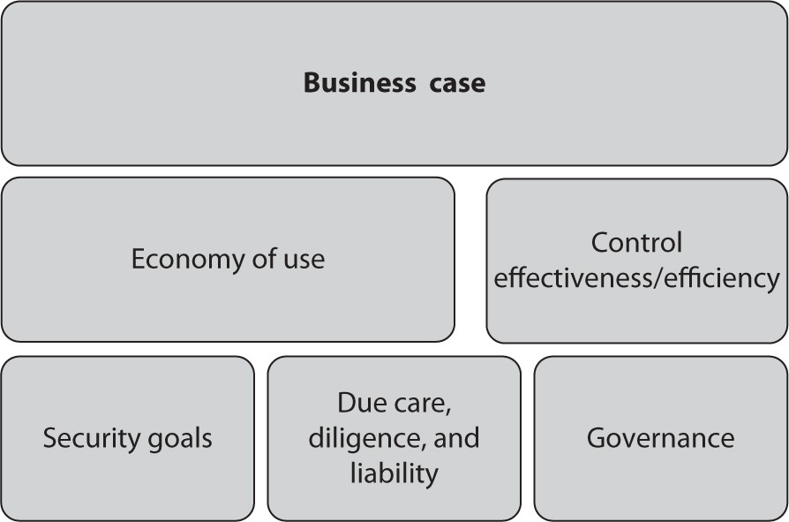
Economy and Efficiency of Use
The business case should discuss why a particular control is effective in mitigating a particular risk.
The business case should try to examine controls that follow the principle of economy of use.

Slide 38
Business Functions and Controls
From a business perspective, controls are also there to protect the integrity and continuity of business functions.
Business functions, such as sales, human resources or accounting processes, or even processes that take place with third parties, are all also considerations when designing and implementing controls.

Slide 39
Internal Functions
Internal functions such as
  human resources, accounting,
  security, production, marketing, and so on.
Controls may be necessary to protect information systems within the organization, typically from an access control perspective, based on the sensitivity of systems and information
Controls should be considered that protect data on the internal infrastructure, using access controls, rights, permissions and privileges, encryption, and so on. Policies are also important controls that protect internal systems and information.
When developing business cases for controls, don’t neglect internal systems and data.
Internal controls serve to protect data from threats such as malicious insiders, employee neglect, and accidental access, modification, or destruction.

Slide 40
External Functions
Most organizations put a higher priority on protecting external functions, such as
  External websites, and other potentially publicly accessible data.
  The typical example of a control that protects external functions is a firewall.
Strong authentication, encryption, third-party, agreements, and other access controls should be used to protect external functions and data.

Slide 41
Cross-boundary Functions
Functions that tend to cross the physical and logical boundaries of the organization between the internal and external networks. Are most difficult to secure simply because data must pass between the internal and external boundaries of the infrastructure, so they can’t be completely closed off from the outside world.
security control used to protect and separate internal and external boundaries, such as:
  Firewalls, multifactor authentication, and data encryption
Controls must be selected and implemented that protect and restrict any and all access that is actually allowed from the external to the internal network, and vice versa.

Slide 42
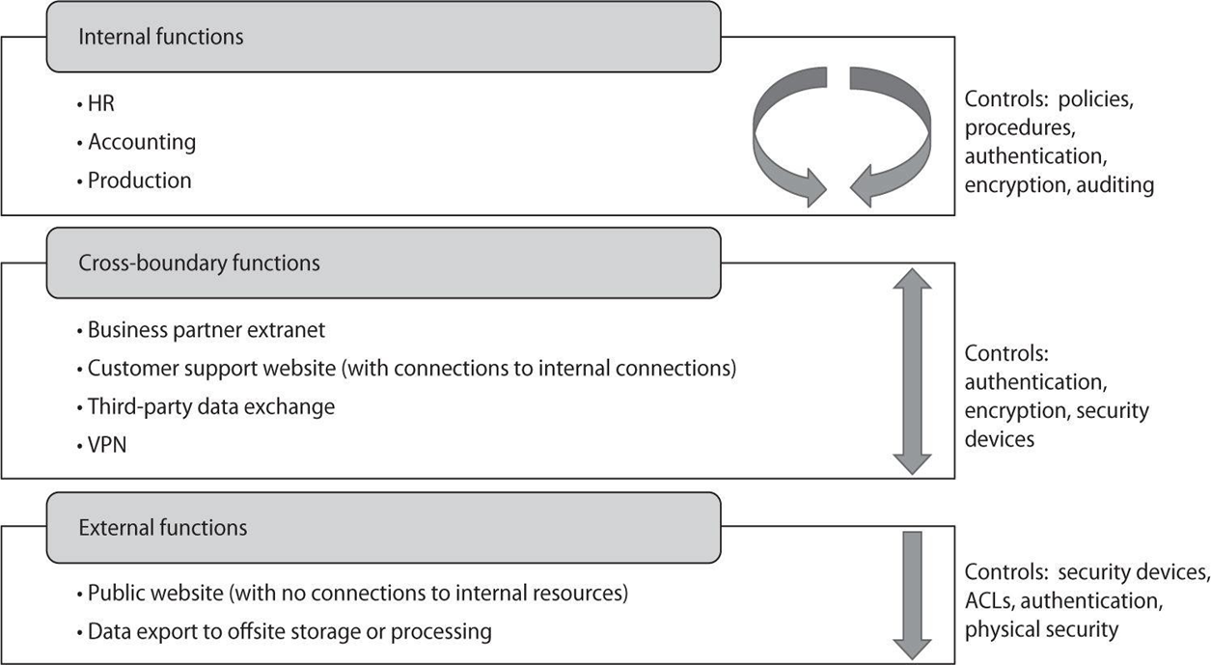
Examples of internal, external, and cross-boundary functions and controls

Slide 43
Regulatory Guidance and Controls
Control implementation is heavily influenced by governance.
Different governance requirements mandate the use of specific control frameworks.
Some are concerned with meeting security requirements and leave the control framework decision to the organization, based upon their particular needs.

Slide 44
Control Design and Selection
  Once the specific shortcomings of existing controls and configurations are understood, the next step is to design or select controls to close the gap between the current state and an acceptable level of risk.
  Controls may be proactive meaning that they attempt to prevent an incident or reactive meaning that they support the detection, containment and recovery of operations should an incident occur.
  Because these are different roles, proactive controls are sometimes called safeguards, while reactive controls are often called countermeasures.
  For example, a sign that warns a person about a risk of fire is a safeguard against a fire starting, while a fire extinguisher or sprinkler system is a countermeasure that puts one out should it start.
  Every enterprise has controls. In general, an effective control is one that prevents, detects or contains an incident, or enables recovery from a risk event.
  However, the purpose of a control is specifically to maintain risk at an acceptable level.

Slide 45
Compensating controls address weaknesses through concepts such as layered defense, increased supervision, or increased audits and logging of system activity. Compensating controls must be effective and protect the identified assets or processes.
the risk practitioner should consider not only functionality but also maintenance and sustainability.
Whether controls will be automated or manual, fail-safe (open) or secure (closed) or provide inputs to other controls or processes are all factors that should be considered.

Slide 46
Thank you

